Slide 1
TNSDC- Machine Learning to Generative AI
DEEPTHI T S
715521104007
B.E CSE- IIIyr
PSG Institute of Technology and Applied Research

Slide 2
Project Title: TextArtify - Text-to-Image Generation
TextArtify is an innovative project aimed at bridging the gap between textual descriptions and visual representations by leveraging cutting-edge AI technologies. The project utilizes advanced text-to-image generation techniques to automatically generate high-quality images from textual prompts.
TextArtify opens up exciting possibilities for artists, designers, writers, marketers, and anyone else looking to effortlessly transform textual ideas into vibrant visual creations. Whether you're brainstorming concepts for a project, illustrating a story, or designing products, TextArtify empowers you to bring your ideas to life with stunning visual imagery.

Slide 3
Agenda
Problem Statement
Problem Overview
Hardware and Software Requirements
Solution
Model Used
End Users
Value Proposition
Result
Conclusion

Slide 4
Problem Statement
To develop an AI-powered text-to-image generation system that accurately translates textual descriptions into visually compelling images, ensuring realism, coherence, and fidelity to the input text. A platform will cater to users across various domains by providing a user-friendly interface that empowers individuals, regardless of their artistic skills, to effortlessly transform textual ideas into vibrant visual creations. Through the integration of advanced AI models and intuitive design, we seek to democratize the process of creating visual artwork, making it accessible and enjoyable for all users.

Slide 5
Problem Overview
The project entails the development of an AI-powered text-to-image generation system, aiming to accurately translate textual descriptions into visually captivating images. Employing state-of-the-art AI technologies, the platform facilitates users to input textual prompts, subsequently generating high-quality images that maintain realism, coherence, and fidelity to the provided text. Targeting users across various domains such as digital art, content creation, e-commerce, and visual storytelling, the platform ensures to meet the diverse expectations of its users. Moreover, the system features a user-friendly interface designed to be accessible to individuals regardless of their artistic proficiency, empowering users to effortlessly transform their textual concepts into vivid visual representations. Through this endeavor, the project endeavors to redefine the landscape of visual content creation, fostering efficiency, accessibility, and creativity in the process.

Slide 6
Hardware Requirements
CPU: Any modern CPU with multiple cores, such as Intel Core i5 or AMD Ryzen series, is sufficient for running the software.
RAM: A minimum of 8 GB of RAM is recommended for smooth execution of Python scripts and machine learning tasks. However, higher RAM capacity (16 GB or more) is preferable for handling larger datasets and more complex models.
Internet Connection: A stable internet connection is required for accessing online resources, libraries, and collaborative platforms like Google Colab.

Slide 7
Software Requirements
Python: Python is the primary programming language used for development.
TensorFlow/Keras: TensorFlow and Keras are deep learning libraries widely used for building and training neural networks.
NumPy: NumPy is a fundamental package for scientific computing with Python, providing support for large, multi-dimensional arrays and matrices, along with a collection of mathematical functions to operate on these arrays.
Pandas: Pandas is a powerful data manipulation and analysis library for Python, particularly useful for handling structured data.
Google Colab: Google Colab is a cloud-based platform that provides free access to GPUs and TPUs for running Python notebooks.

Slide 8
Solution- Stable Diffusion Model
The solution integrates Stable Diffusion, a cutting-edge AI model, to generate high-quality images from textual descriptions. Users input text prompts, and Stable Diffusion transforms them into visually compelling images through a sophisticated image generation process. Users can customize parameters such as image size and style preferences. Real-time feedback allows users to review and adjust generated images, ensuring they meet quality standards. Overall, by leveraging Stable Diffusion, the solution provides an efficient and powerful tool for transforming text into vibrant visual representations, meeting the diverse needs of users across different domains.

Slide 9
The Stable Diffusion Model
The Stable Diffusion model is a state-of-the-art AI model specifically designed for generating high-quality images from textual descriptions. The Stable Diffusion model extends the principles of diffusion probabilistic models to generate images from textual descriptions. It learns to map textual descriptions to corresponding images by conditioning the diffusion process on the input text. During inference, the model takes a textual description as input and generates a sequence of images that gradually evolve into the target image described by the text.
To generate an image from a textual description, the Stable Diffusion model iteratively refines a base image using the diffusion process. At each step, noise is added to the base image, and the resulting noisy image is denoised to produce the next image in the sequence. By conditioning the diffusion process on the input text, the model ensures that the generated images align with the semantics and content of the description.

Slide 10
End Users
The end users of the text-to-image generation system could include individuals and professionals across various domains who require visual content creation. Some potential end users may include:
Digital Artists
Content Creators
E-commerce Platforms
Writers and Storytellers
Educators and Trainers
Designers and Creative Professionals
General Users

Slide 11
Value Proposition
The text-to-image generation system presents several compelling advantages:
Efficiency: By automating image generation from textual descriptions, the platform streamlines content creation, saving users time and resources compared to manual methods.
Accessibility: Featuring an intuitive interface, the platform ensures that users of all artistic skill levels can easily create visual content from text, democratizing the image generation process.
Quality: Leveraging advanced AI technologies, the system produces images with realism, coherence, and fidelity to the input text, meeting user expectations across diverse domains.
Versatility: Catering to a broad spectrum of users spanning digital art, content creation, e-commerce, and visual storytelling, the platform offers a versatile solution for generating images from text.
Cost-effectiveness: Eliminating the need for expensive design software and manual labor, the platform provides a cost-effective means of producing high-quality visual content from text.

Slide 12
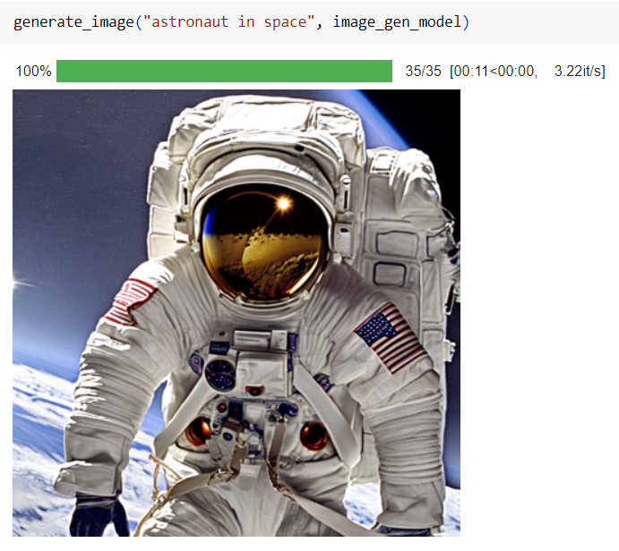
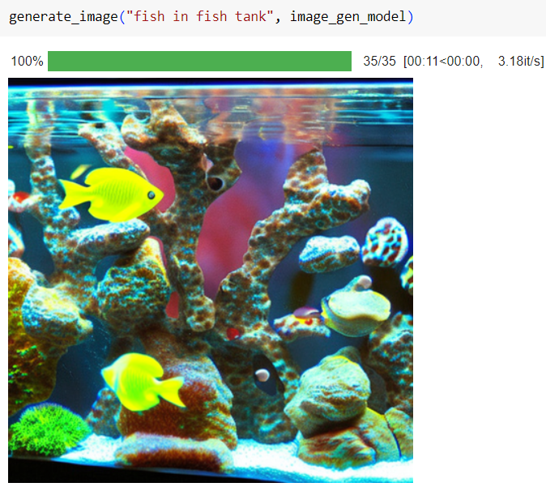
Result

Slide 13
Conclusion
In conclusion, the text-to-image generation project employing the Stable Diffusion model has successfully demonstrated its ability to translate textual descriptions into visually captivating images. Through the integration of advanced AI technologies and meticulous modeling, the project has showcased its capacity to generate high-quality images that closely align with the input text. The project's core value lies in its capacity to streamline visual content creation, offering efficiency, accessibility, and versatility to users across different domains. By automating the process of image generation from textual descriptions, the platform empowers individuals and businesses to express their ideas creatively, irrespective of their artistic proficiency. Moreover, the cost-effectiveness of the solution and its user-friendly interface make it a practical and valuable tool for content creators, designers, educators, and beyond.

Slide 14
Thank you

